Slide 1
Session 17
Advanced Features of ASP.NET Core 2.1
For Aptech Centre Use Only

Slide 2
Session Overview
Describe Data Access with ASP.NET Core 2.1 and EF Core
Explain creation of Razor Pages application using Entity Framework (EF) Core
Describe deploying ASP.NET Core 2.1 applications
For Aptech Centre Use Only

Slide 3
Data Access with ASP.NET Core 2.1 and EF Core
Razor Pages in ASP.NET Core 2.1 have several benefits including better organized structure of the project files.
EF Core is a lightweight, extensible, and cross-platform version of Entity Framework.
ASP.NET Core Razor Pages together with EF Core can be used to build Web apps for Create, Read, Update, and Delete (CRUD) operations, sorting, filtering, and so on.
For Aptech Centre Use Only

Slide 4
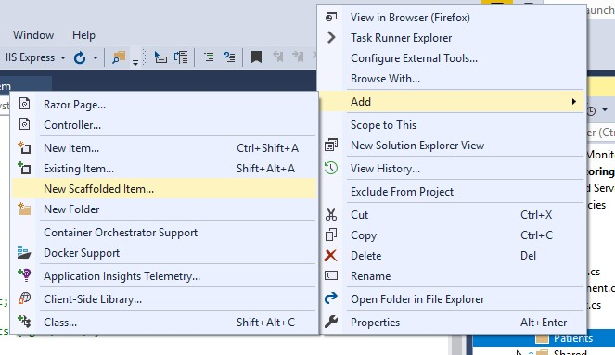
Creating Razor Pages Application Using EF Core (1-5)
Click File → New. In the New Project dialog box, click .NET Core in the left pane and
ASP.NET Core Web Application in the right pane.
Specify the name PatientMonitoringSystem and click OK.
In the subsequent dialog box, select ASP.NET Core 2.1 in the top drop-down and Web Application as the template.
Click OK. The project will be created.
Next, create a new folder named Models and within it, a class file named Patient.cs having code as given in Code Snippet 1.
Similarly, create other entities such as Doctor and PatientEnrollment as shown in Code
Snippets 2 and 3 respectively.
Edit _Layout.cshtml to delete default content. Add the line that is bold in Code Snippet 4.
In Solution Explorer, right-click Pages/Patients folder and select Add → New Scaffolded
Item.
For Aptech Centre Use Only
Adding Scaffolded Item

Slide 5
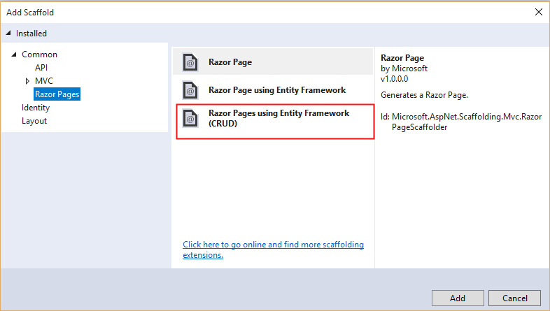
Creating Razor Pages Application Using EF Core (2-5)
In the Add Scaffold dialog box, select Razor Pages using Entity Framework (CRUD) → Add.
In the Add Razor Pages using Entity Framework (CRUD) dialog box, under Model class drop-down, select Patient (PatientMonitoringSystem.Models).
For Aptech Centre Use Only
Adding Scaffolded Item for CRUD

Slide 6
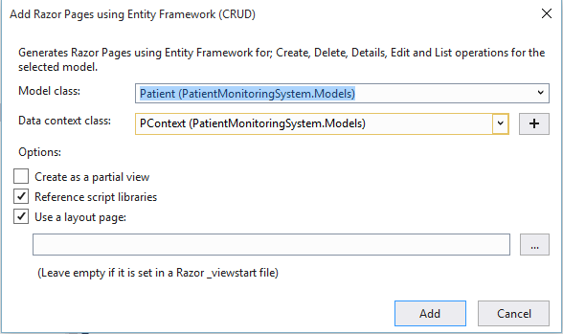
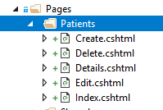
Creating Razor Pages Application Using EF Core (3-5)
In the Data context class row, select the + (plus) sign and change the generated name to PatientMonitoringSystem.Models.PMContext.
Click Add. Views will be generated for Create, Delete, Index, Details, and Edit actions.
For Aptech Centre Use Only
13. Build and execute the application.

Slide 7
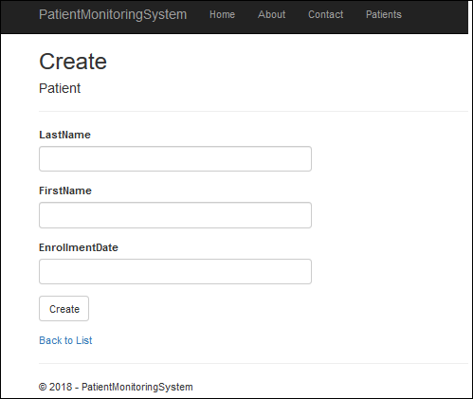
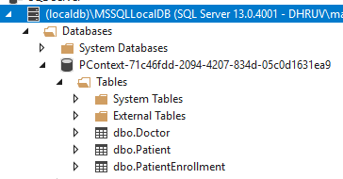
Creating Razor Pages Application Using EF Core (4-5)
Click Patients. Then, click Create New.
Add a record and click Create.
Click View → SQL Server Object Explorer to see the local database and tables generated.
For Aptech Centre Use Only

Slide 8
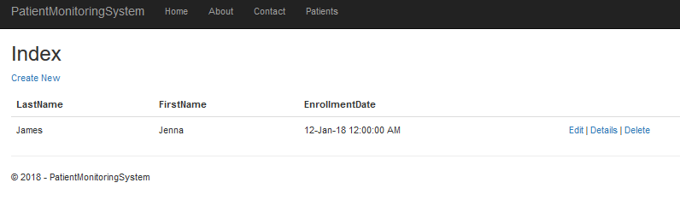
Creating Razor Pages Application Using EF Core (5-5)
17. Right-click the table Patient and select View Data. The record entered through the browser page will be displayed in the table.
For Aptech Centre Use Only

Slide 9



Deploying ASP.NET Core 2.1 Applications
An ASP.NET Core app can be deployed:
As a self-contained local application by publishing to a folder
As a Windows service
To the cloud via Microsoft Azure
On IIS
For Aptech Centre Use Only
When publishing to a local folder, publish folder will contain .exe and .dll files for the app, its dependencies, and optionally, the .NET runtime.
Besides these files, the publish folder for an ASP.NET Core app also contains configuration files, static assets, and MVC views.
•
Developers can publish ASP.NET Core Web apps to the cloud (on Azure App Service) using
Visual Studio 2017 or from the command line.

Slide 10
Summary
Razor Pages in ASP.NET Core 2.1 have several benefits including better organized structure of the project files.
EF Core is a lightweight, extensible, and cross-platform version of Entity Framework.
ASP.NET Core Razor Pages together with EF Core can be used to build Web apps for CRUD operations, sorting, filtering, and so on.
ASP.NET Core Web apps can be deployed to a local folder, as a Windows service, as
a Web application on IIS, or on the cloud on Azure App service.
For Aptech Centre Use Only

